Slide 1
Air Quality Index Analysis
Presented by Group 10:
Ewansiha Simmons, Kendall Young & Phil Faulkner

Slide 2
Overview
Air Pollution poses serious threat to public health
4.2 million deaths per year are due to ambient air pollution
91% of world’s population lives in areas where air quality levels are over
WHO guidelines
Air Quality Index (AQI) provides metric warning citizens about danger of air pollution at varying levels of intensity
Rankings: Good to Hazardous Air Quality
Variables affected by Air Quality?
Population
Death Rate
Pre-/-Post Covid

Slide 3
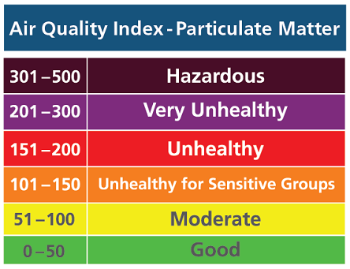
Air Quality Index

Slide 4
Resources
Most Polluted Cities and Countries (IQAir Index)
https://www.kaggle.com/datasets/ramjasmaurya/most-polluted-cities-and-countries-iqair-index?datasetId=2029905
Covid-19 Air Pollution Data
https://www.kaggle.com/datasets/ramjasmaurya/most-polluted-cities-and-countries-iqair-index?datasetId=2029905
Life Expectancy at Birth (2019/2020)
https://ourworldindata.org/grapher/life-expectancy-at-birth-total-years?tab=table

Slide 5
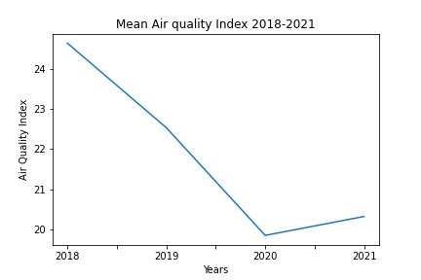
AQI Movement (Pre-Covid vs. Post-Covid)
Year | AQI
2018 | 23.64
2019 | 22.53
2020 | 19.85
2021 | 20.32

Slide 6
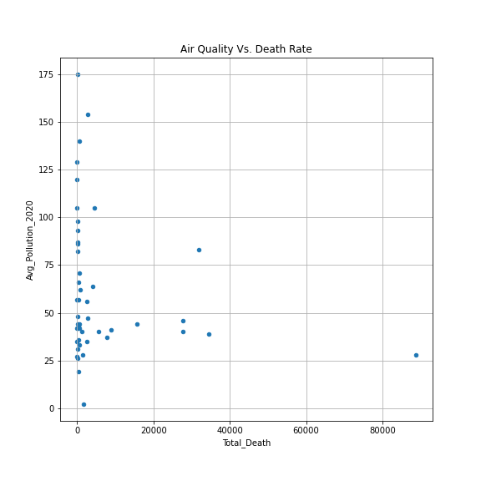
AQI vs Death Rate

Slide 7
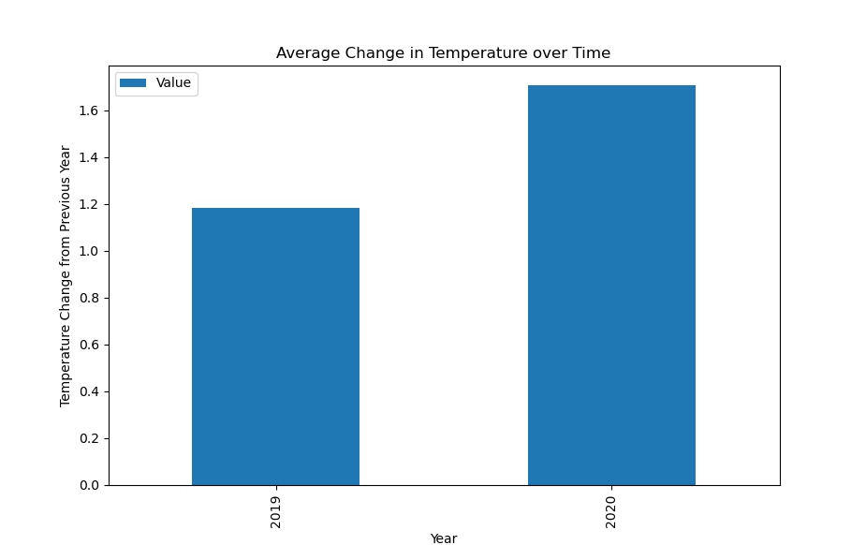
Avg. Temperature Change
(Pre-Covid/Post-Covid)
+1.71
+1.18

Slide 8
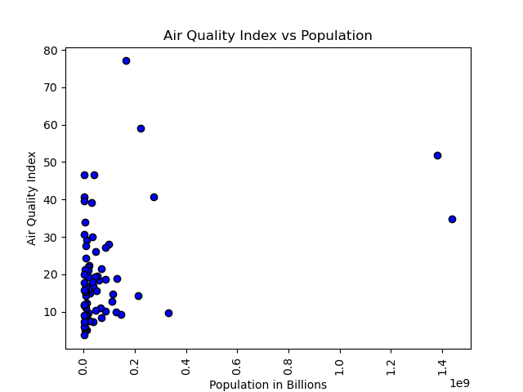
AQI vs Population

Slide 9
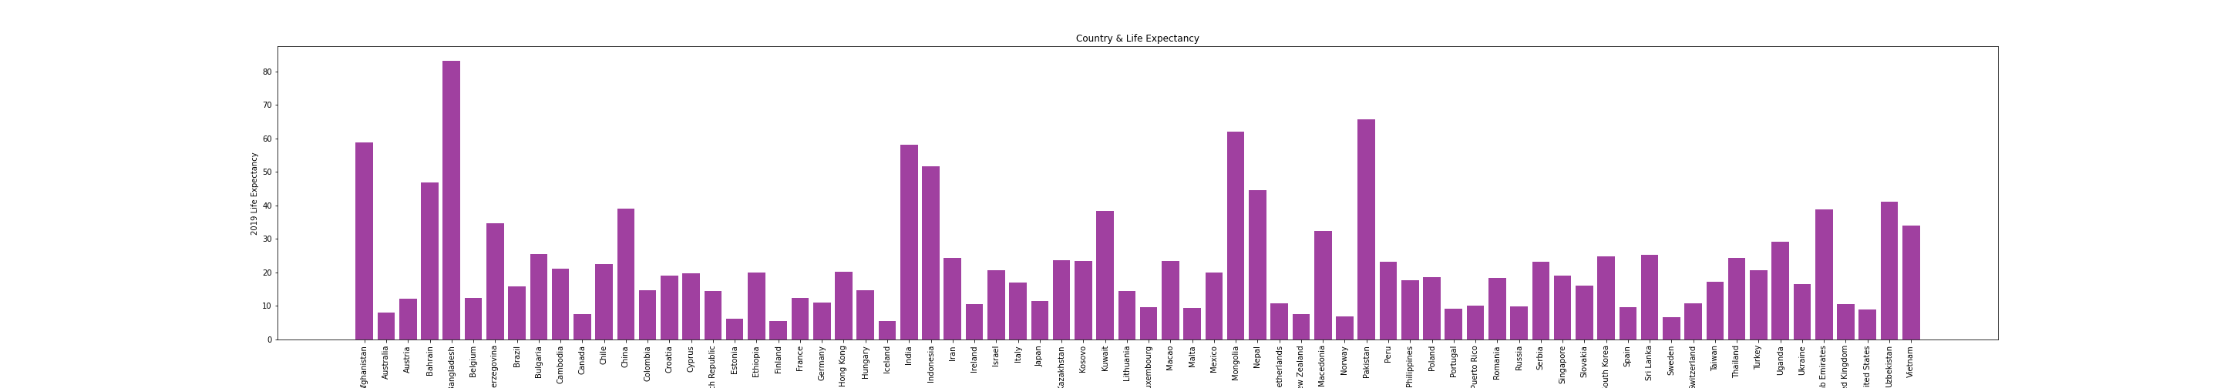
AQI vs Life Expectancy

Slide 10
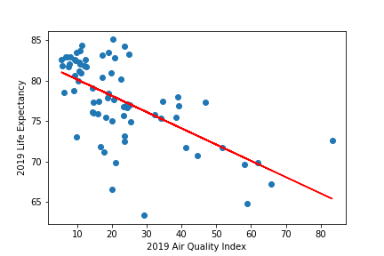
AQI/Life Expectancy Relationship
Y = -0.2X +82.14

Slide 11
Recommendation/Next Steps
Continue research/analysis that will provide more answers from our initial findings
Review years prior to 2017 to further evaluate Pre-Covid/Post-Covid AQI
Continue to review temperature change Post-Covid (2020) to confirm if relationship can be established
No proven relationship between large population (country) & higher AQI can be established; will the same be proven if we researched population by cities?
Established relationship between AQI/Life Expectancy; are there other factors that may be influencers?
Further analysis on correlations between AQI and specific illnesses, especially respiratory ailments
QUESTIONS?
Thank you for listening to our presentation!

